Slide 1
C# project: LEGO® analogy Project MEGO
Oleksii Kosobutskyi and Adam Czub

Slide 2

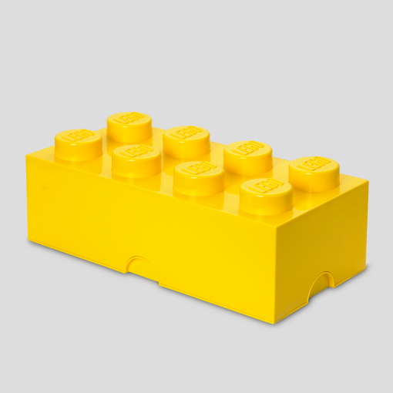
The main idea
https://commons.wikimedia.org/wiki/File:Official_unity_logo.png
Application written in Unity environment
Creative game
MEGO: interactive possibility of playing with LEGO without real blocks
Designing tool
Great fun for kids and adults
https://roomcopenhagen.com/wp-content/uploads/2014/02/4004-LEGO-Storage-Brick-8-Bright-Yellow-510x510.png

Slide 3


Functionality
3D space for building shapes
Different blocks designs
Blocks size dependent on smallest possible MEGO brick
Possibility to change colours of blocks
Every angle view and zooming of made project
https://cdn.britannica.com/48/182648-050-6C20C6AB/LEGO-bricks.jpg
https://www.google.com/earth/outreach/images/tutorials_tb_17_map_controls.gif

Slide 4
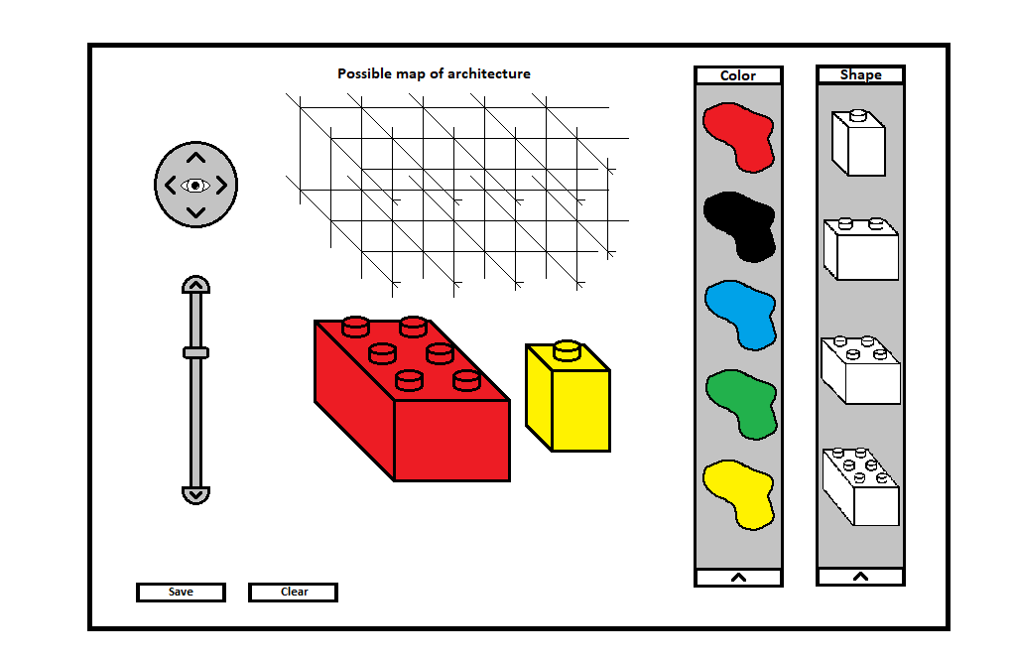
Design

Slide 5
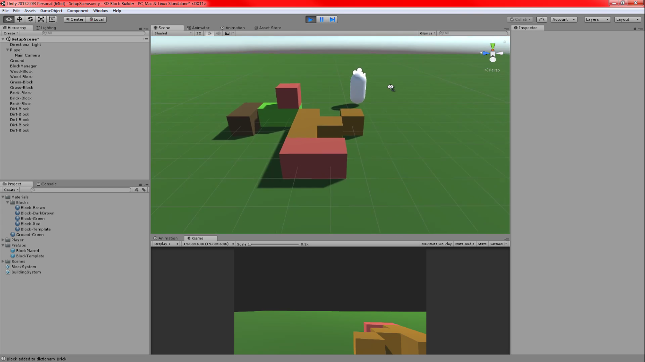
Prototype
https://www.youtube.com/watch?v=0WZUgUtBxcg

Slide 6
Interesting knowledge
Mouse pointing in 3D space:
RaycastHit buildPosHit;
if (Physics.Raycast(playerCamera.ScreenPointToRay(new Vector3(Screen.width / 2, Screen.height / 2, 0)), out buildPosHit, 10, buildableSurfacesLayer)) {
Vector3 point = buildPosHit.point;
buildPos = new Vector3(Mathf.Round(point.x), Mathf.Round(point.y), Mathf.Round(point.z));
canBuild = true;
} else {
Destroy(currentTemplateBlock.gameObject);
canBuild = false;
}

Slide 7
Future upgrades
Integration with real life game
Introducing physics (what do we study it for?)
Different complicated shapes of elements
Designing own shapes of elements
Saving project in STL format for 3D printing

Slide 8
References
Unity Tutorial - 3D Block System - Pt 2: Tutorial – YouTube https://www.youtube.com/watch?v=0WZUgUtBxcg
UnityScripts/3D Block System Tutorial at master · c00pala/UnityScripts https://github.com/c00pala/UnityScripts/tree/master/3D%20Block%20System%20Tutorial

Slide 9
Thank you for your attention
Have a nice day ☺

